Slide 1
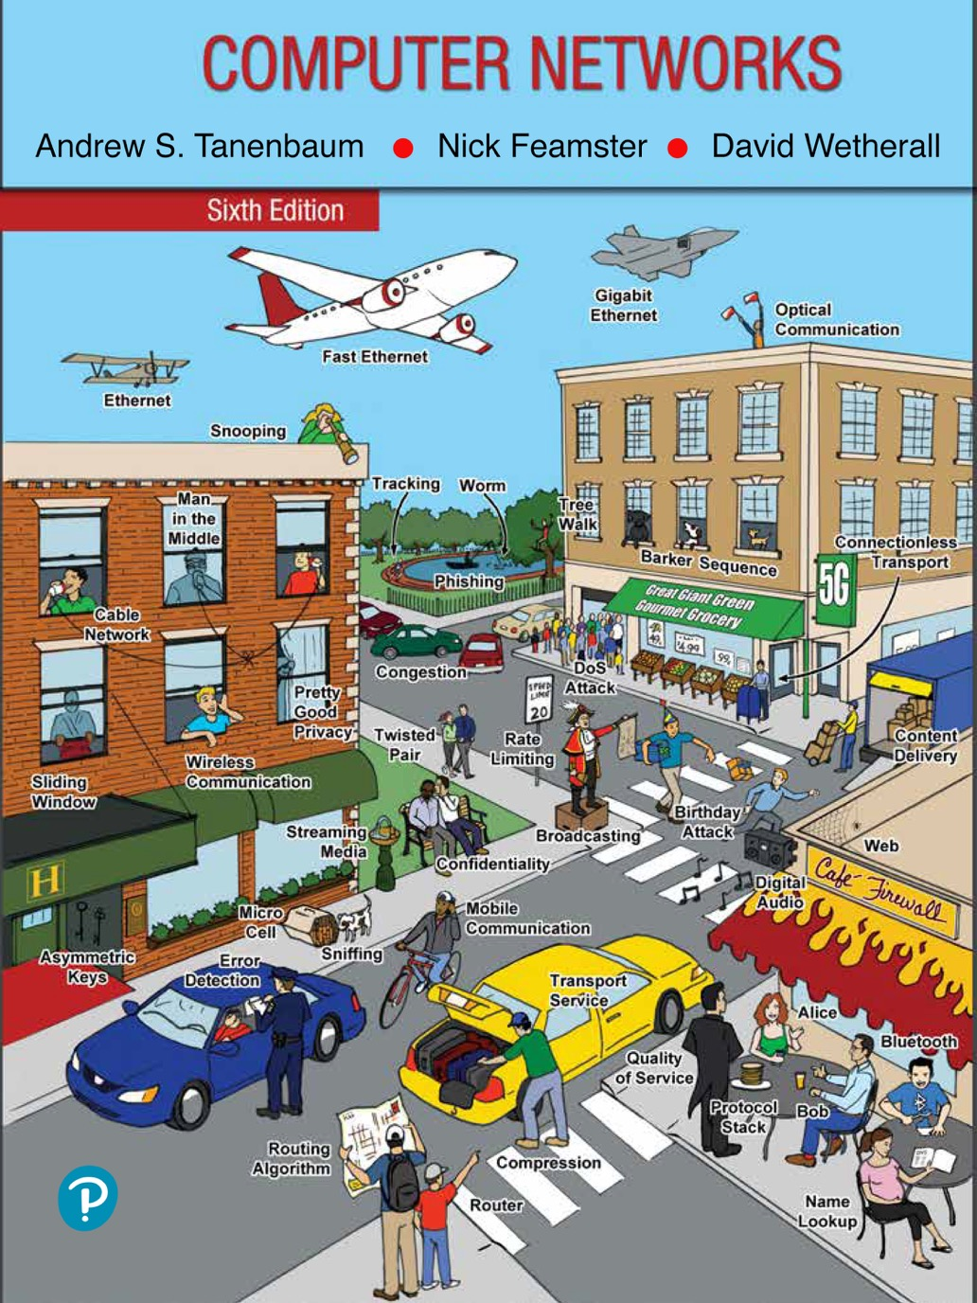
Chapter 7
The Application Layer

Slide 2
The Domain Name System (DNS)
History and overview
The DNS lookup process
The DNS name space and hierarchy
DNS queries and responses
Name resolution
Hands on with DNS
DNS privacy
Contention over names

Slide 3
History and Overview
ARPANET days
hosts.txt listed all computer names and their IP addresses
Hosts fetched the file nightly
Worked reasonably well for the time
The Internet grew
The hosts.txt file grew to be large
Needed central management to prevent host name conflicts
Domain Name System invented in 1983
Hierarchical naming scheme
Distributed database system implements the naming scheme
Maps host names to IP addresses

Slide 4
The DNS Lookup Process
Stub resolver process to map a name onto an IP address
Stub resolver sends a query containing the name to a local DNS resolver
Local DNS resolver performs a recursive lookup for the name against a set of DNS resolvers
Local recursive resolver ultimately returns the corresponding IP address to the stub resolver
Stub resolver passes the result to the function that issued the query in the first place
Query and response messages are sent as UDP packets
Program can use the IP address to communicate with the host corresponding to the DNS name that it had looked up

Slide 5
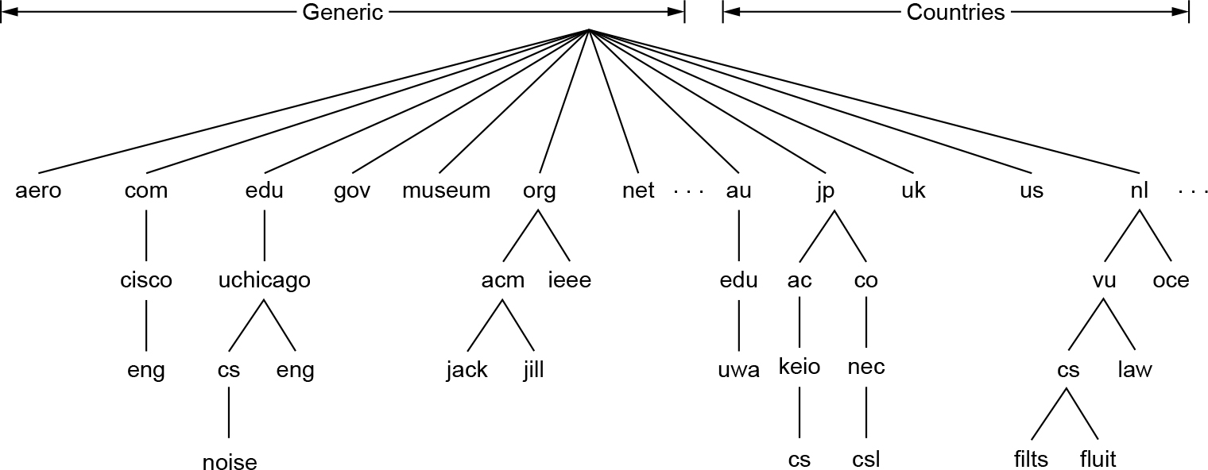
The DNS Name Space and Hierarchy (1 of 3)
A portion of the Internet domain name space

Slide 6
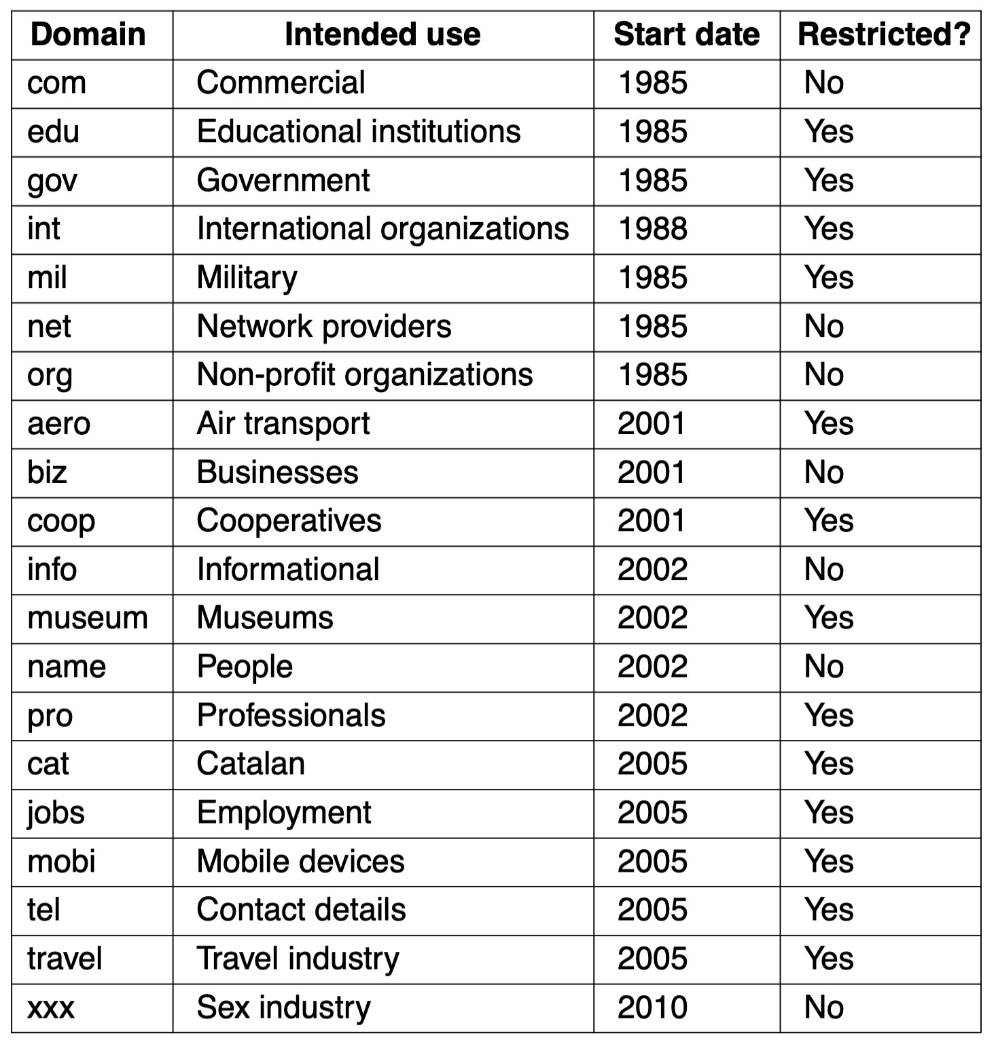
The DNS Name Space and Hierarchy (2 of 3)
The original generic TLDs, as of 2010. As of 2020, there are more than 1,200 gTLDs.

Slide 7
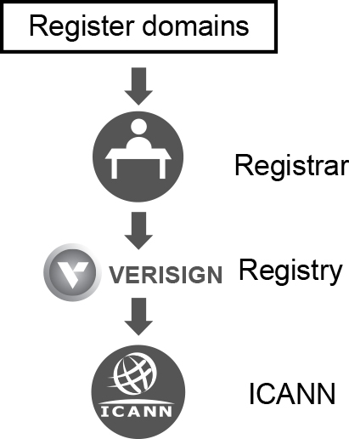
The DNS Name Space and Hierarchy (3 of 3)
The relationship between registries and registrars

Slide 8
DNS Queries and Responses (1 of 4)
DNS queries
Extensions and enhancements to DNS queries
DNS responses and resource records
Common record types
DNSSEC records
DNS zones

Slide 9
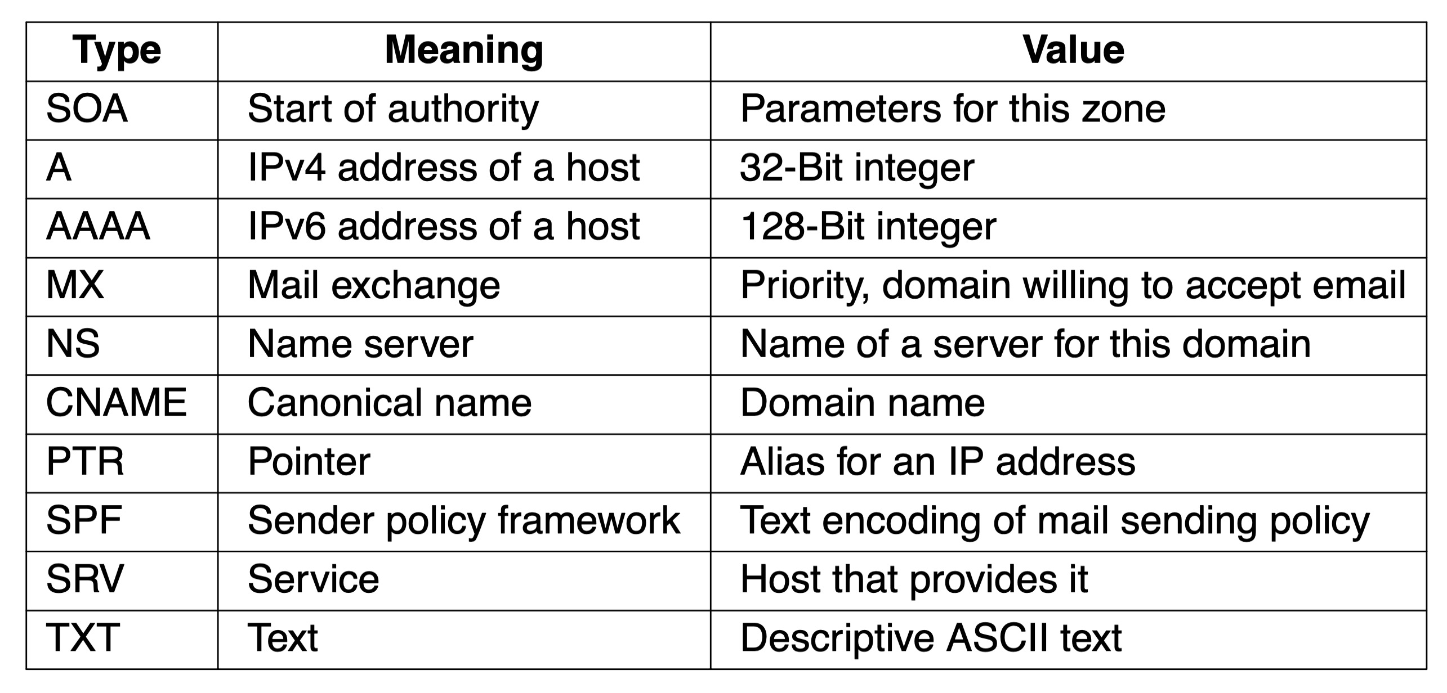
DNS Queries and Responses (2 of 4)
The principal DNS resource record types

Slide 10
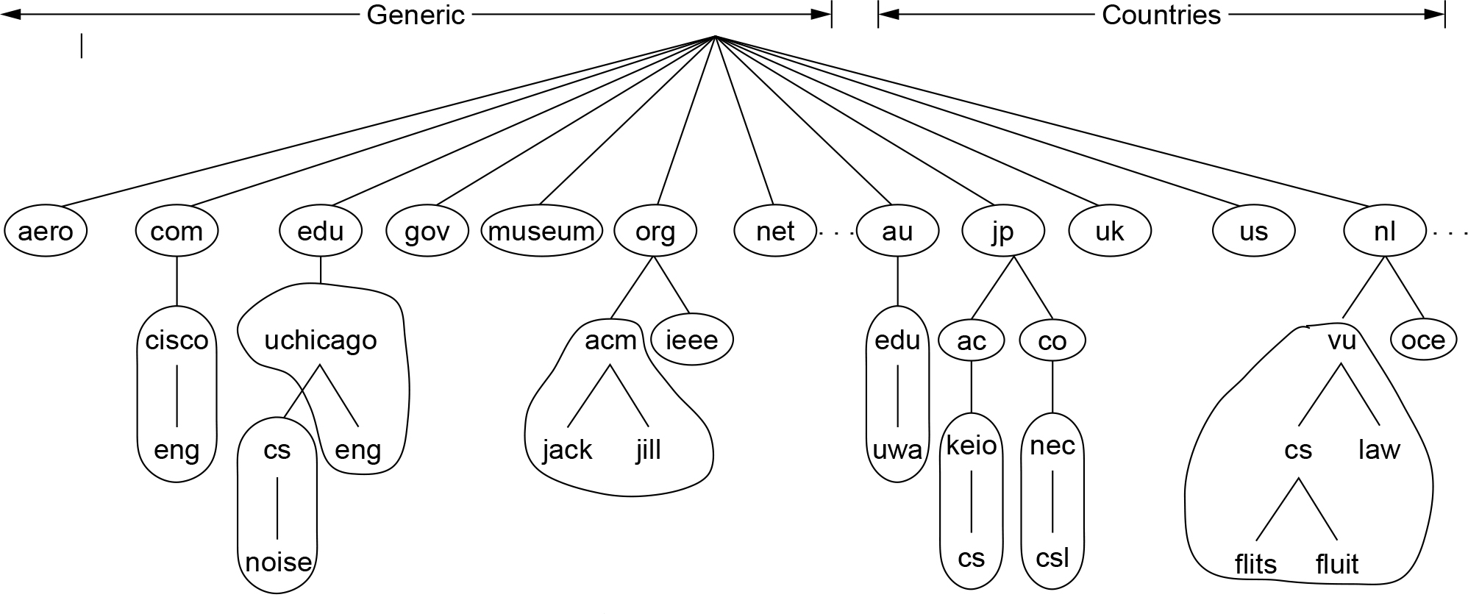
DNS Queries and Responses (4 of 4)
Part of the DNS name space divided into zones (which are circled)

Slide 11
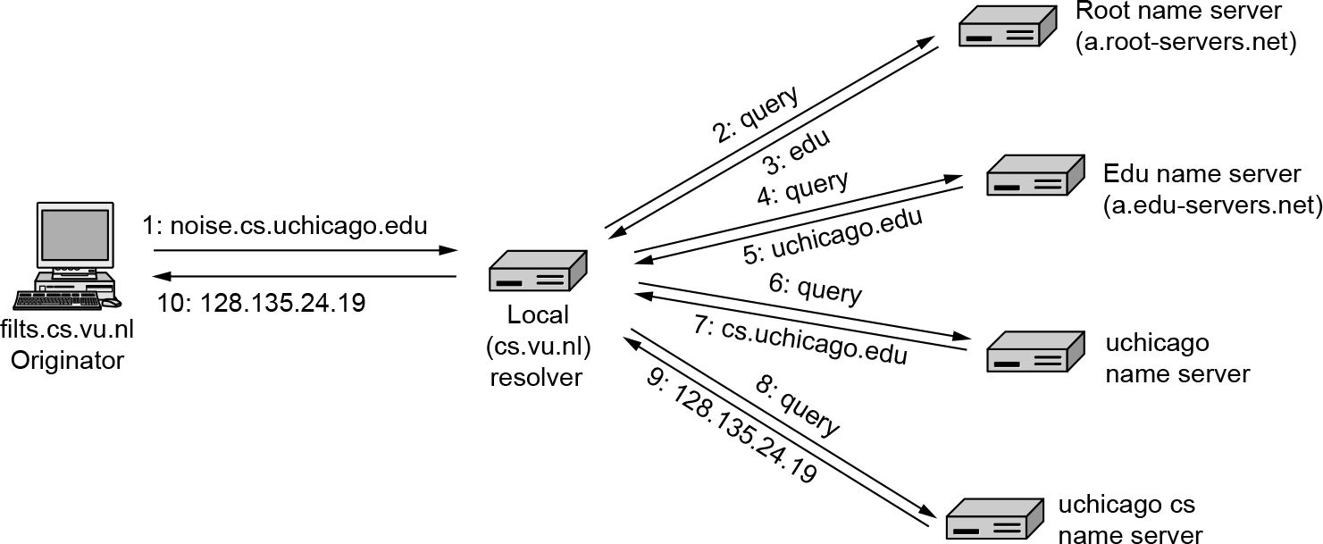
Name Resolution
Example of a resolver looking up a remote name in 10 steps

Slide 12
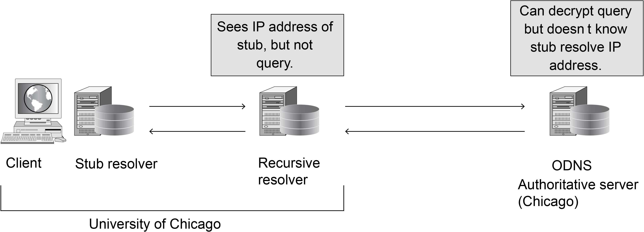
DNS Privacy
Oblivious DNS

Slide 13
Electronic Mail
Architecture and services
The user agent
Message formats
Message transfer
Final delivery

Slide 14
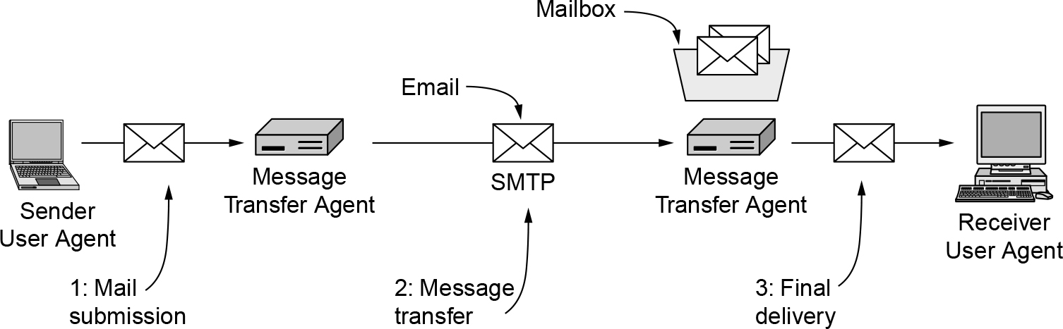
Architecture and Services (1 of 2)
Architecture of the email system

Slide 15
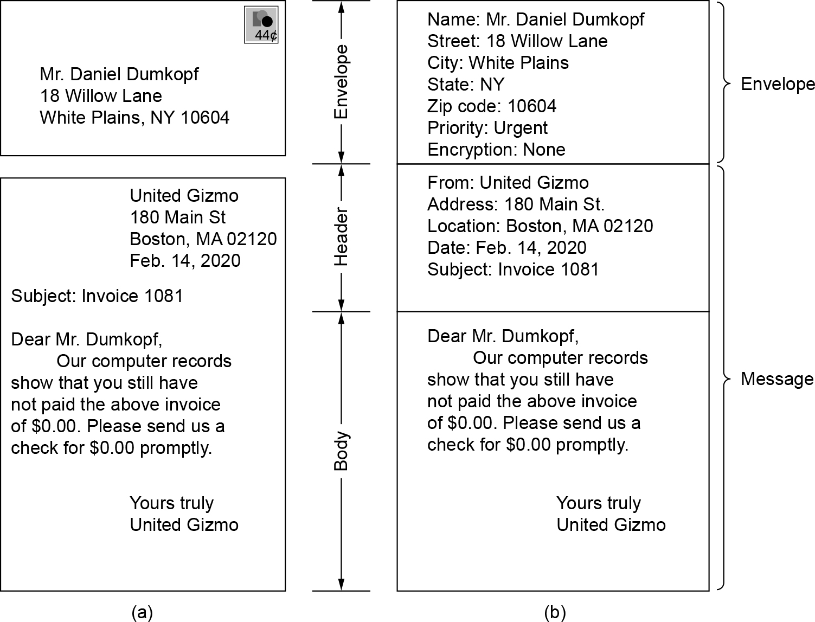
Architecture and Services (2 of 2)
Envelopes and messages. (a) Paper mail. (b) Electronic mail.

Slide 16
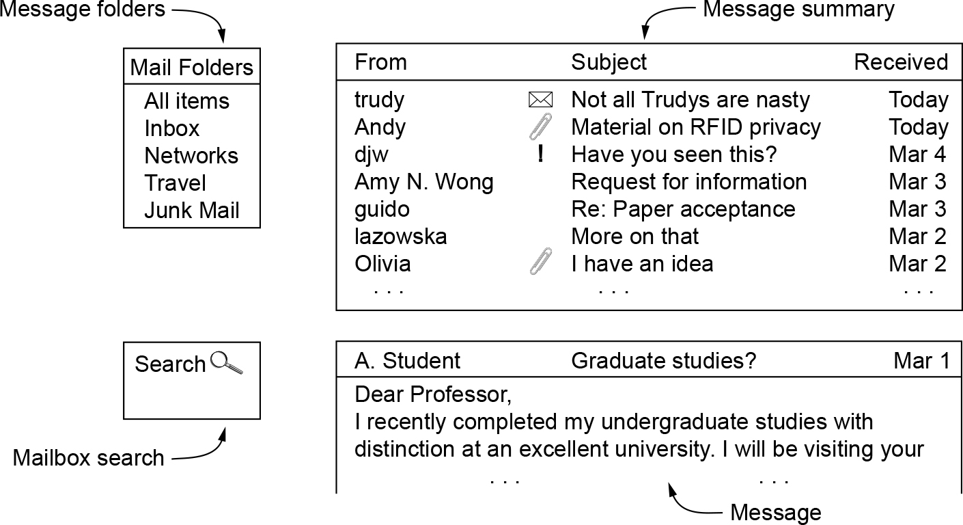
The User Agent
Typical elements of the user agent interface.

Slide 17
Message Formats (1 of 5)
RFC 5322—the Internet message format
Basic ASCII email using RFC 5322
Latest revision of the original Internet message format
MIME—the Multipurpose Internet Mail Extensions
Multimedia extensions to the basic format

Slide 18
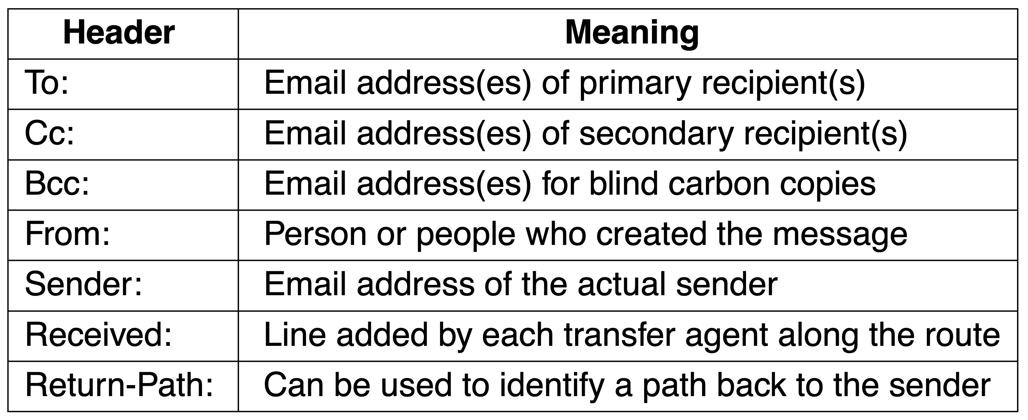
Message Formats (2 of 5)
RFC 5322 header fields related to message transport

Slide 19
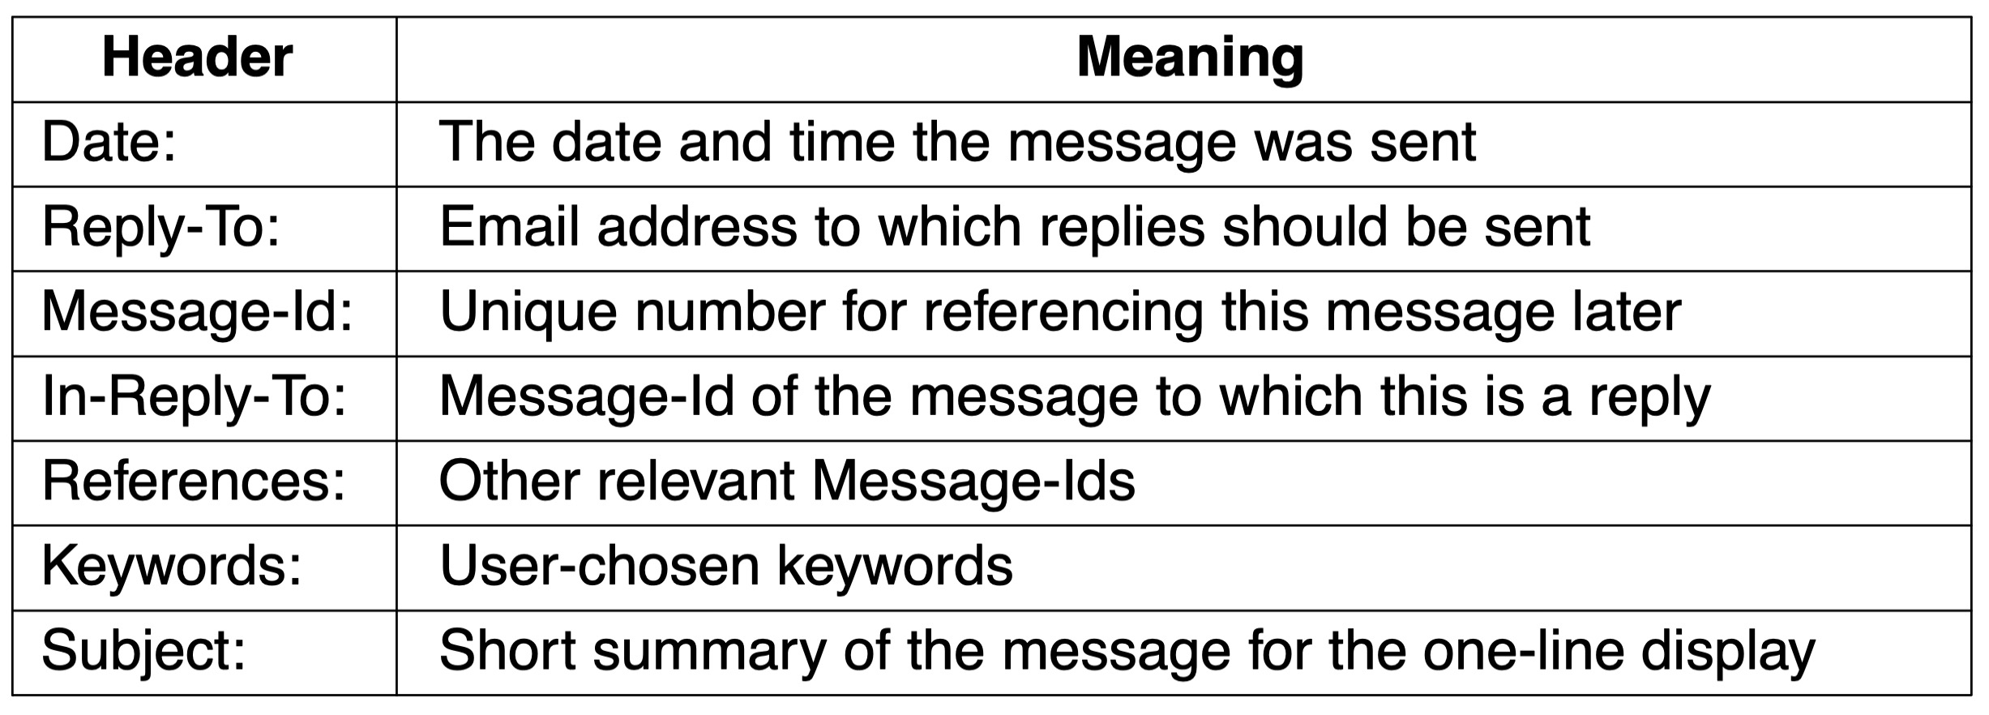
Message Formats (3 of 5)
Some fields used in the RFC 5322 message header

Slide 20
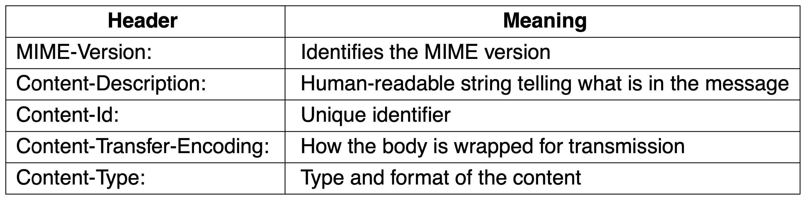
Message Formats (4 of 5)
Message headers added by MIME

Slide 21
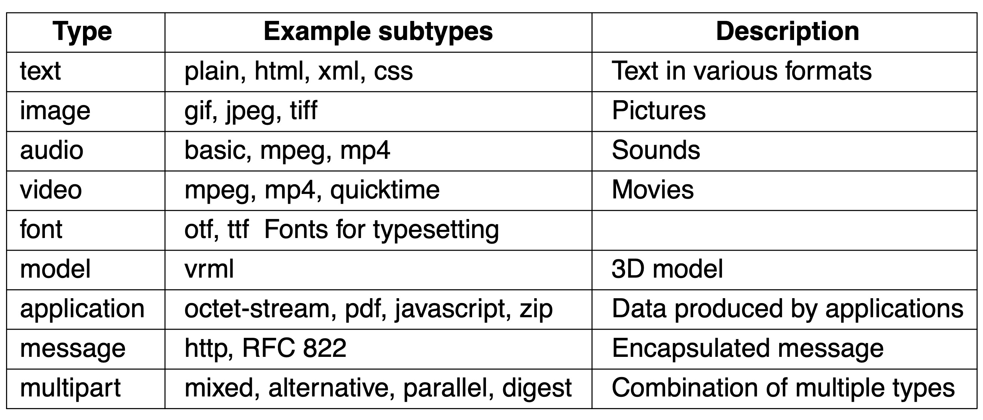
Message Formats (5 of 5)
MIME content types and example subtypes

Slide 22
Message Transfer (1 of 3)
SMTP (Simple Mail Transfer Protocol) and extensions
Mail submission
Physical transfer

Slide 23
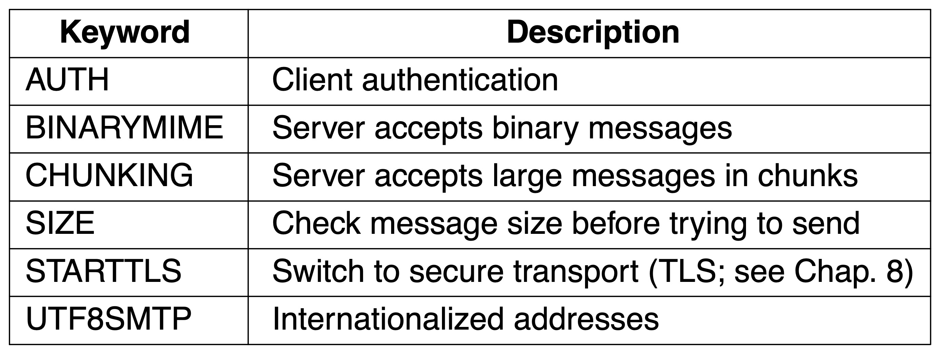
Message Transfer (3 of 3)
Some SMTP extensions

Slide 24
Final Delivery (1 of 2)
IMAP—the Internet Message Access Protocol
Main protocol used for final delivery
Improvement over POP3 (Post Office Protocol, version 3)
The mail server runs an IMAP server that listens to port 143
The user agent runs an IMAP client
The client connects to the server and begins to issue commands
Webmail
Alternative to IMAP and SMTP for providing email service
Uses the Web as an interface

Slide 25
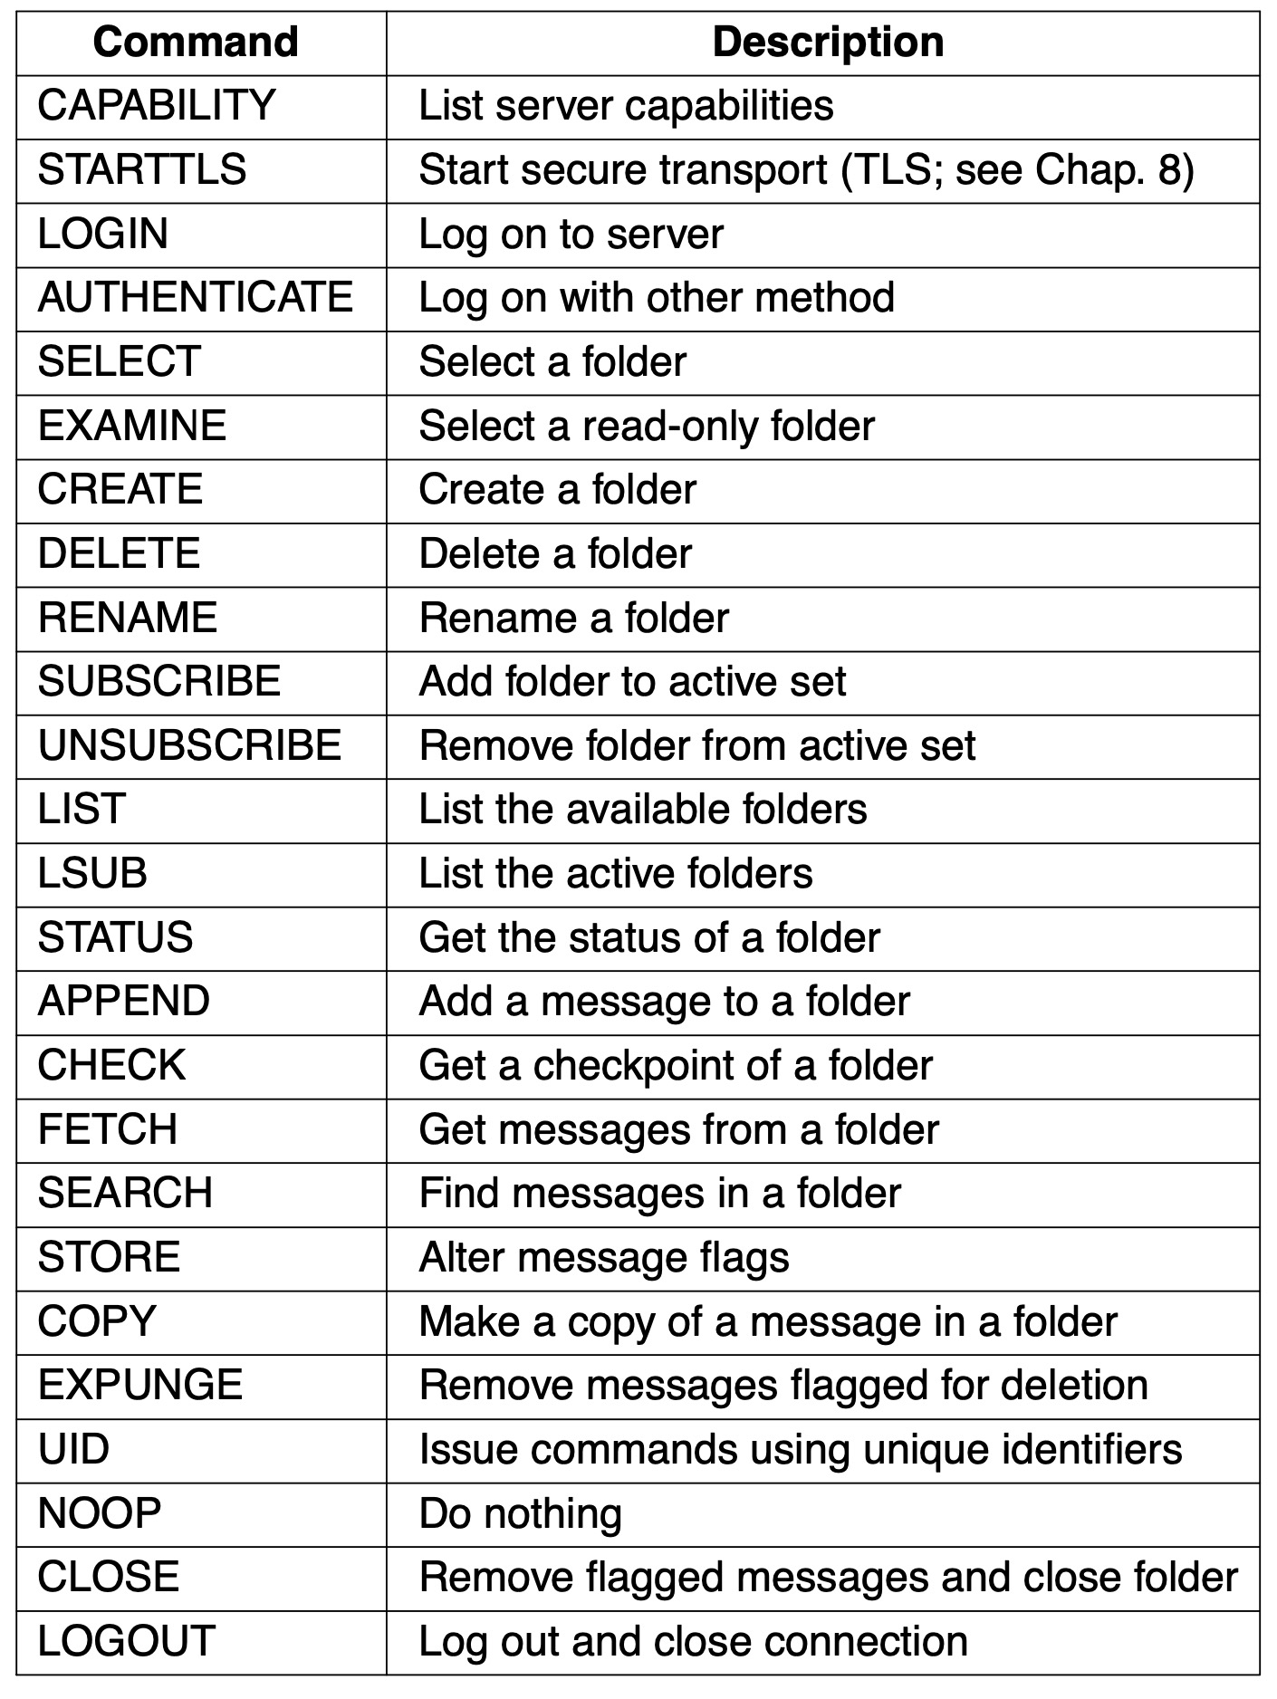
Final Delivery (2 of 2)
IMAP (version 4) commands

Slide 26
The World Wide Web
Architectural overview
Static Web objects
Dynamic Web pages and Web applications
HTTP and HTTPS
Web privacy

Slide 27
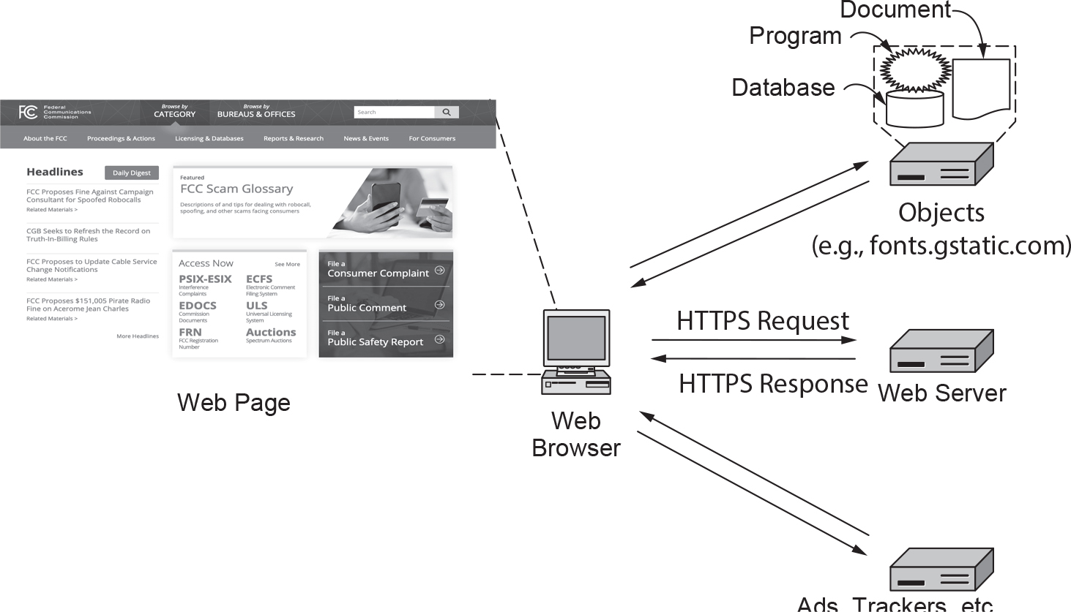
Architectural Overview (1 of 8)
Fetching and rendering a Web page involves HTTP/HTTPS requests to many servers

Slide 28
Architectural Overview (2 of 8)
The client side
Three questions had to be answered before a selected page was displayed:
What is the page called?
Where is the page located?
How can the page be accessed?

Slide 29
Architectural Overview (3 of 8)
Steps that occur when a link is selected:
Browser determines the URL
Browser asks DNS for the IP address of the server
DNS replies
Browser makes a TCP connection
Sends HTTP request for the page
Server sends the page as HTTP response
Browser fetches other URLs as needed
Browser displays the page
The TCP connections are released

Slide 30
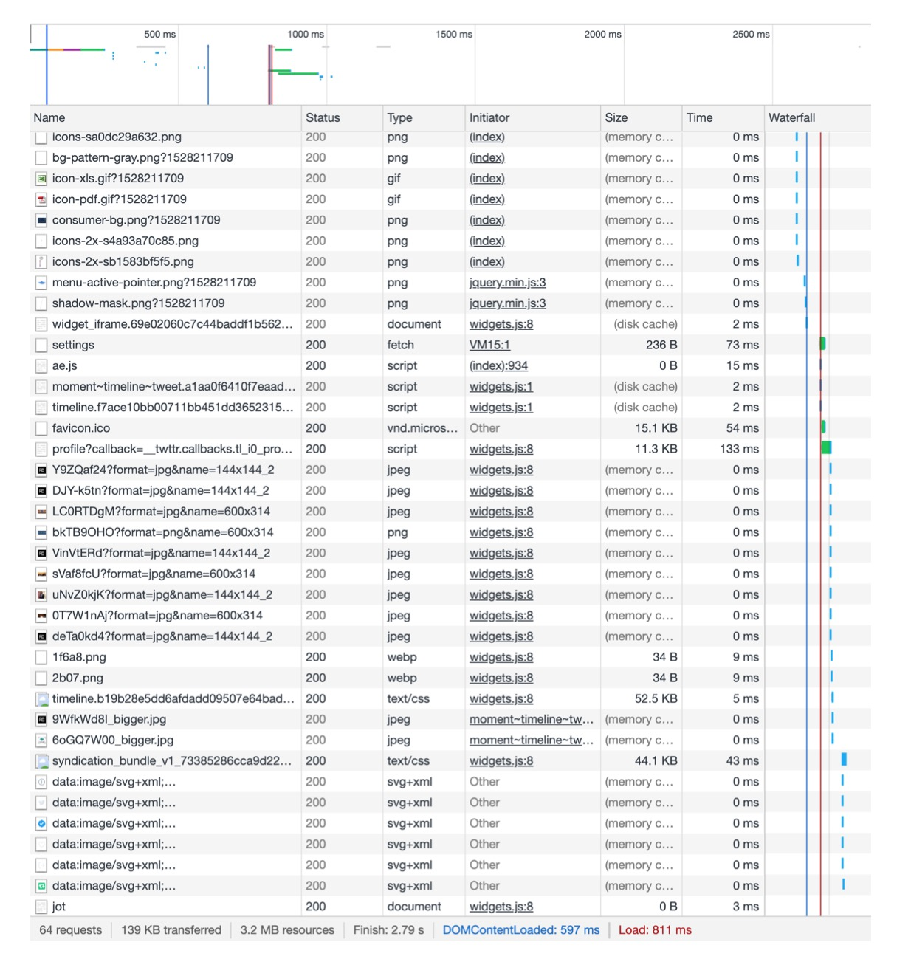
Architectural Overview (4 of 8)
Waterfall diagram for fcc.gov

Slide 31
Architectural Overview (6 of 8)
Steps the server performs in its main loop:
Accept a TCP connection from a client (a browser)
Get the path to the page, which is the name of the file requested
Get the file (from disk)
Send the contents of the file to the client
Release the TCP connection
Modern Web servers have more features
For dynamic content
Third step may be replaced by the execution of a program that generates and returns the contents

Slide 32
Architectural Overview (7 of 8)
Server design problem: slow disk access bottleneck
Solution: maintain a cache in memory
Server design problem: one request processed at a time
Solution: make the server multithreaded
Modern Web architectures use a split between a front end and a back end
Front-end Web server (reverse proxy)
Retrieves content from other (typically back-end) servers
Serves those objects to the client
Acts on behalf of the servers – not on the behalf of clients

Slide 33
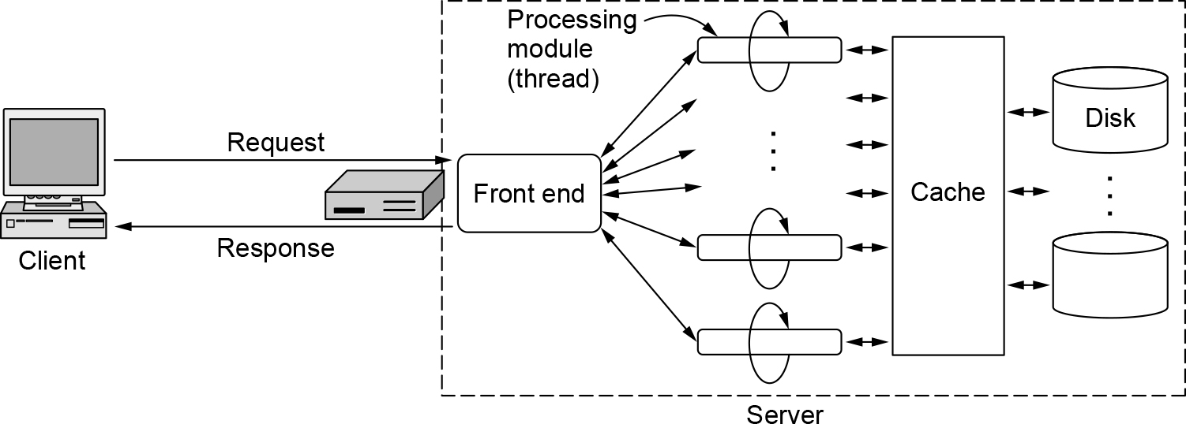
Architectural Overview (8 of 8)
A multithreaded Web server with a front end and processing modules

Slide 34
Static Web Objects
Static objects
Files sitting on a server, presenting themselves in the same way each time they are fetched and viewed
Examples: logo, style sheets, header and footer
Generally amenable to caching
Most Web pages have dynamic content
Significant amount of the content remains static
Web page design
Use HTML or CSS (Cascading Style Sheets)
Use programs (Adobe Dreamweaver)

Slide 35
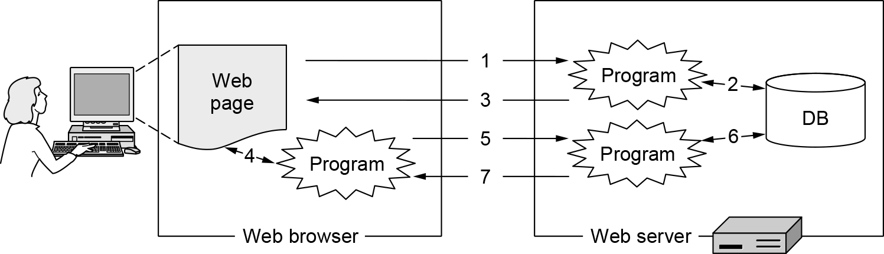
Dynamic Web Pages and Web Applications (1 of 2)
Dynamic pages

Slide 36
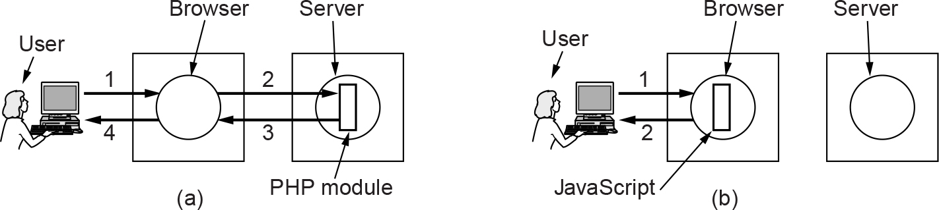
Dynamic Web Pages and Web Applications (2 of 2)
(a) Server-side scripting with PHP. (b) Client-side scripting with JavaScript.

Slide 37
HTTP and HTTPS (1 of 7)
Overview
Methods
Message headers
Caching
HTTP/1 and HTTP/1.1
HTTP/2
HTTP/3

Slide 38
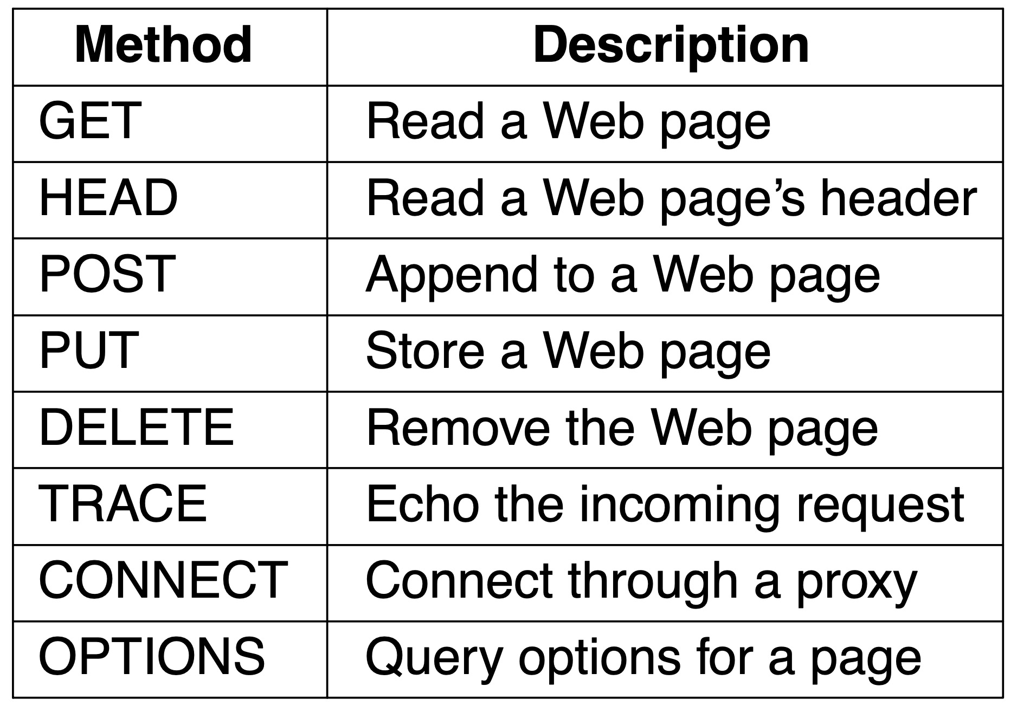
HTTP and HTTPS (2 of 7)
The built-in HTTP request methods

Slide 39
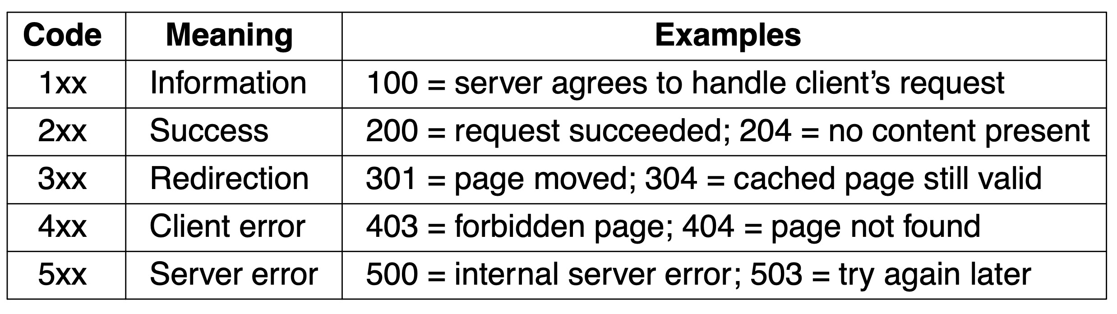
HTTP and HTTPS (3 of 7)
The status code response groups

Slide 40
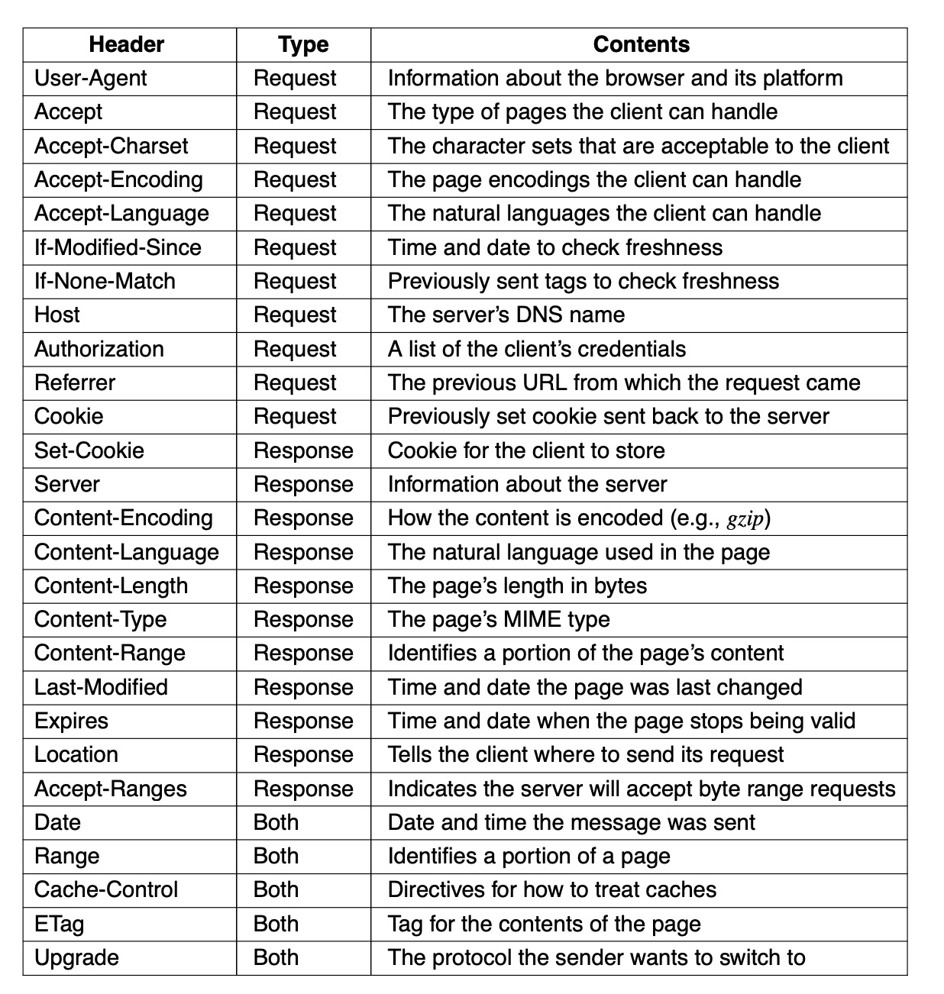
HTTP and HTTPS (4 of 7)
Some HTTP message headers

Slide 41
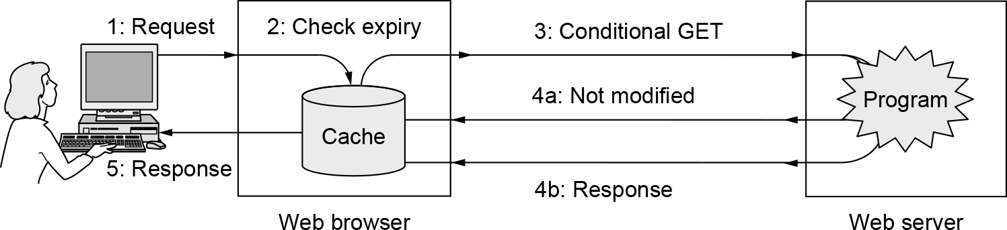
HTTP and HTTPS (5 of 7)
HTTP caching

Slide 42
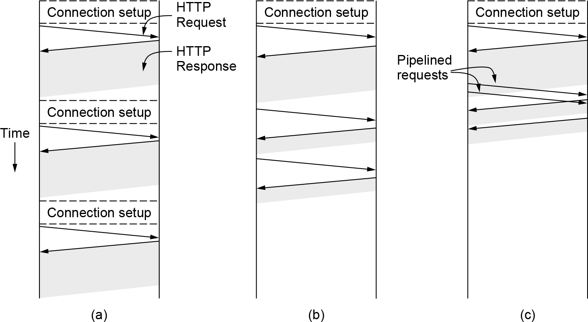
HTTP and HTTPS (6 of 7)
HTTP with (a) multiple connections and sequential requests. (b) A persistent connection and sequential requests. (c) A persistent connection and pipelined requests.

Slide 43
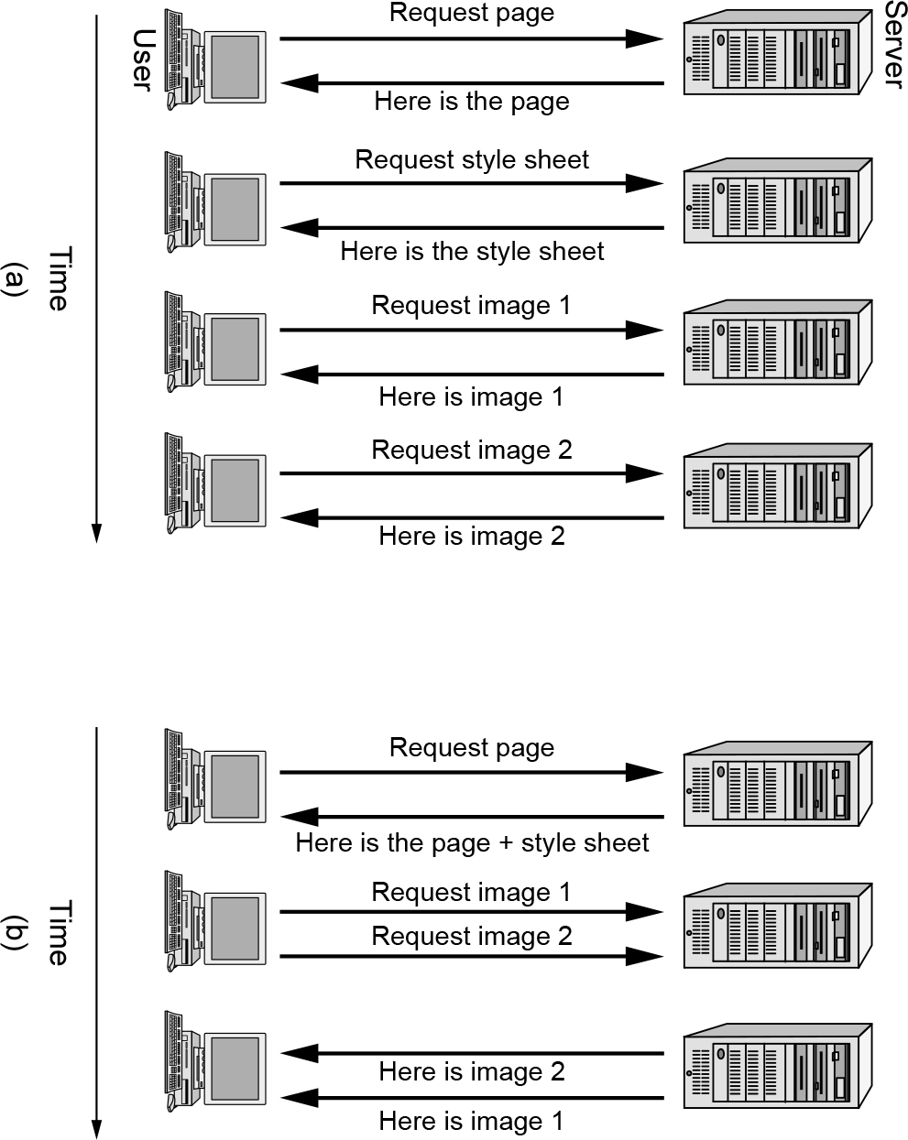
HTTP and HTTPS (7 of 7)
(a) Getting a Web page in HTTP/1.1. (b) Getting the same page in HTTP/2.

Slide 44
Web Privacy
Cookies
Third-party trackers
Device and browser fingerprinting
Cookie syncing

Slide 45
Streaming Audio and Video
Digital audio
Digital video
Streaming stored media
Real-time streaming

Slide 46
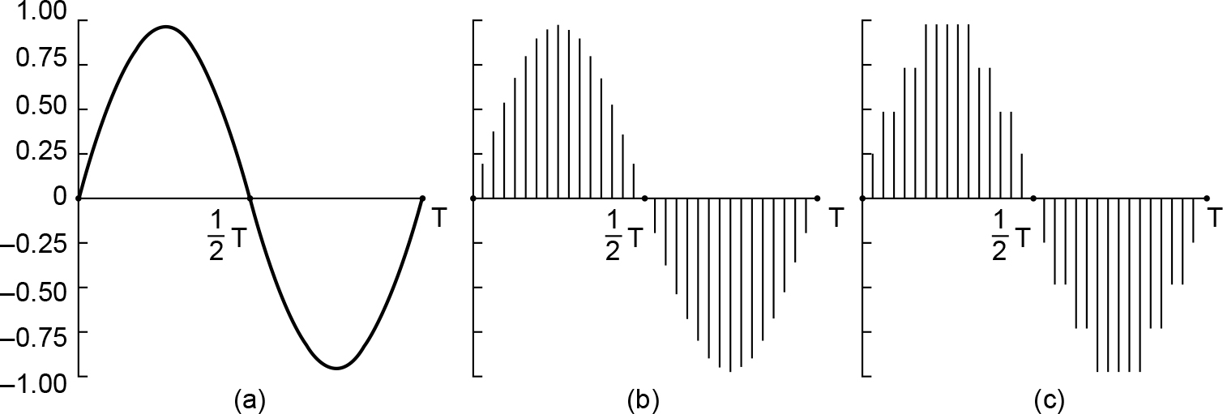
Digital Audio
(a) A sine wave. (b) Sampling the sine wave. (c) Quantizing the samples to 4 bits.

Slide 47
Digital Video (1 of 2)
MPEG frames
I (Intracoded) frames that are self-contained compressed still images
P (Predictive) frames that are difference with the previous frame
B (Bidirectional) frames that code differences with the next I-frame

Slide 48
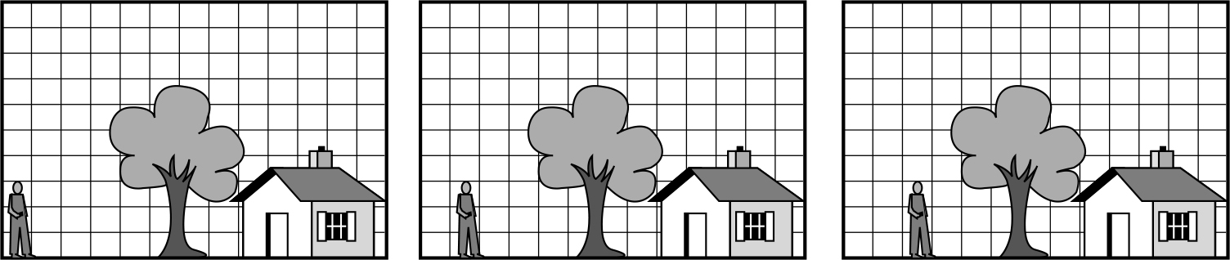
Digital Video (2 of 2)
Three consecutive frames

Slide 49
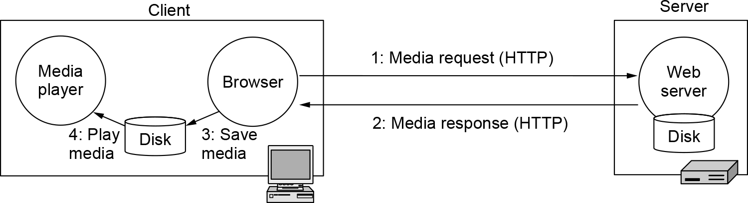
Streaming Stored Media (1 of 4)
Playing media over the Web via simple downloads

Slide 50
Streaming Stored Media (2 of 4)
A media player has five major jobs to do:
Manage the user interface
Handle transmission errors
Decompress the content
Eliminate jitter
Decrypt the file

Slide 51
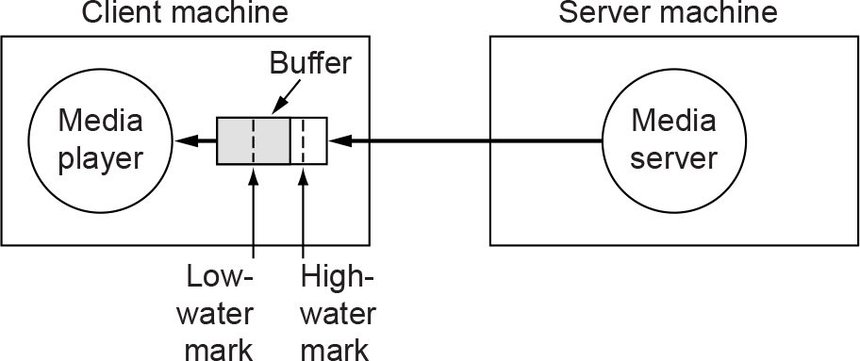
Streaming Stored Media (3 of 4)
The media player buffers input from the media server and plays from the buffer rather than directly from the network.

Slide 52
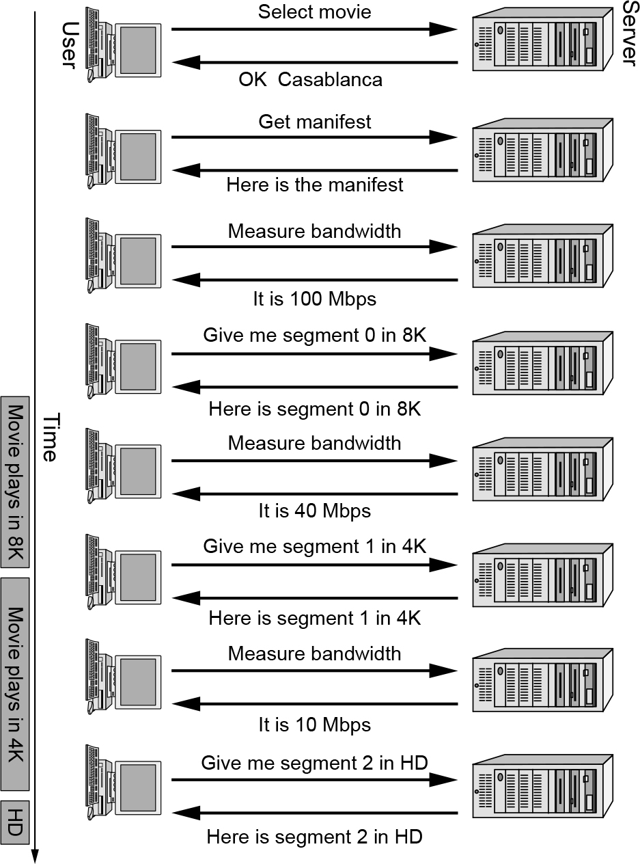
Streaming Stored Media (4 of 4)
DASH being used to change format while watching a movie

Slide 53
Real-Time Streaming (1 of 7)
Voice over IP
H.323
SIP—the Session Initiation Protocol
Comparison of H.323 and SIP

Slide 54
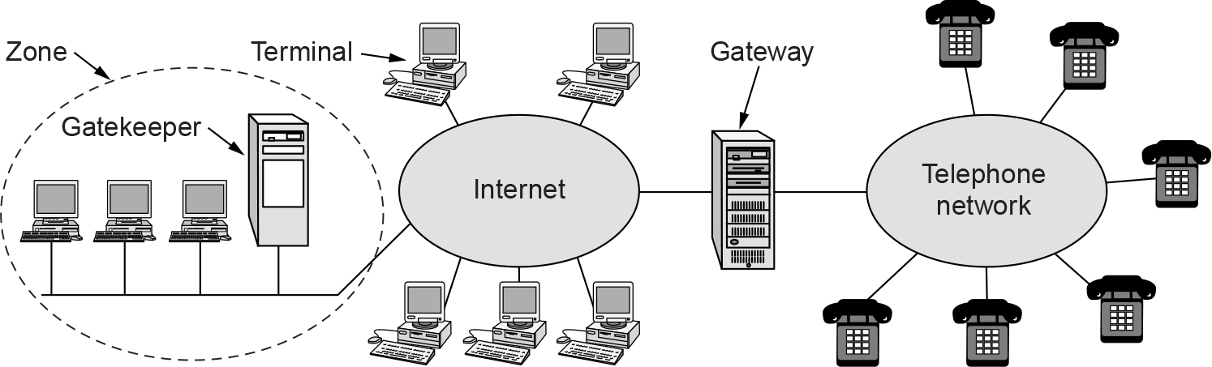
Real-Time Streaming (2 of 7)
The H.323 architectural model for Internet telephony

Slide 55
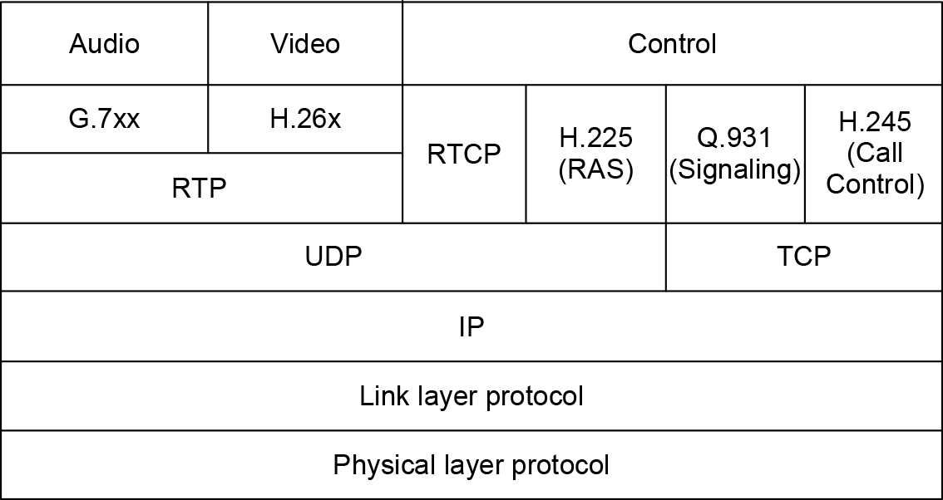
Real-Time Streaming (3 of 7)
The H.323 protocol stack

Slide 56
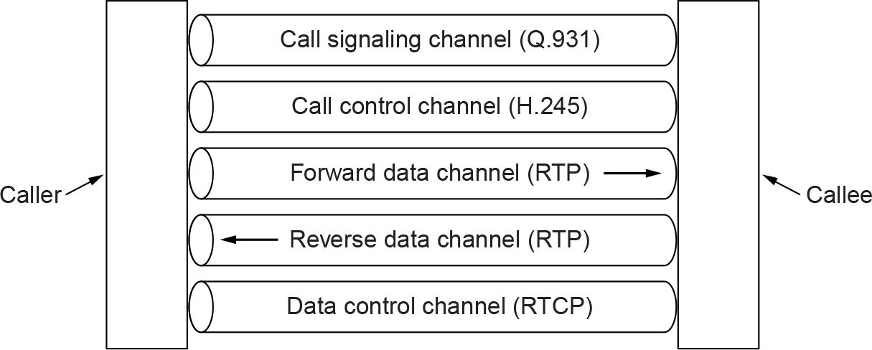
Real-Time Streaming (4 of 7)
Logical channels between the caller and callee during a call

Slide 57
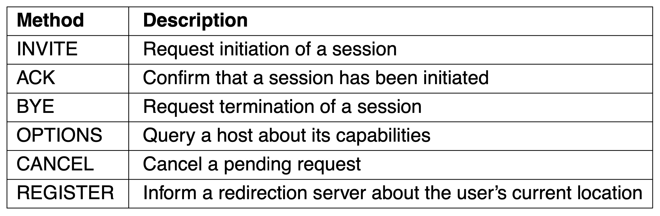
Real-Time Streaming (5 of 7)
SIP methods

Slide 58
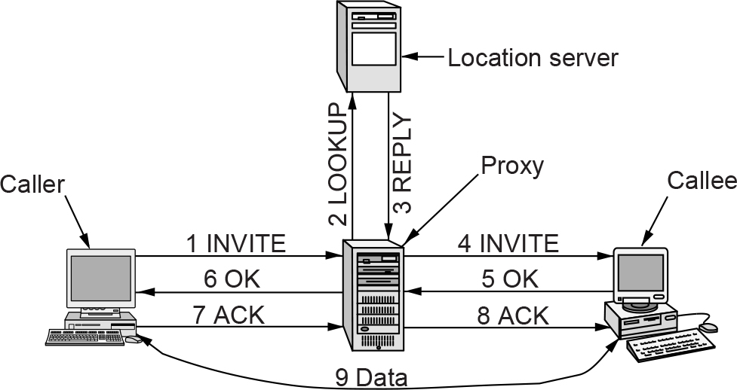
Real-Time Streaming (6 of 7)
Use of a proxy server and redirection with SIP

Slide 59
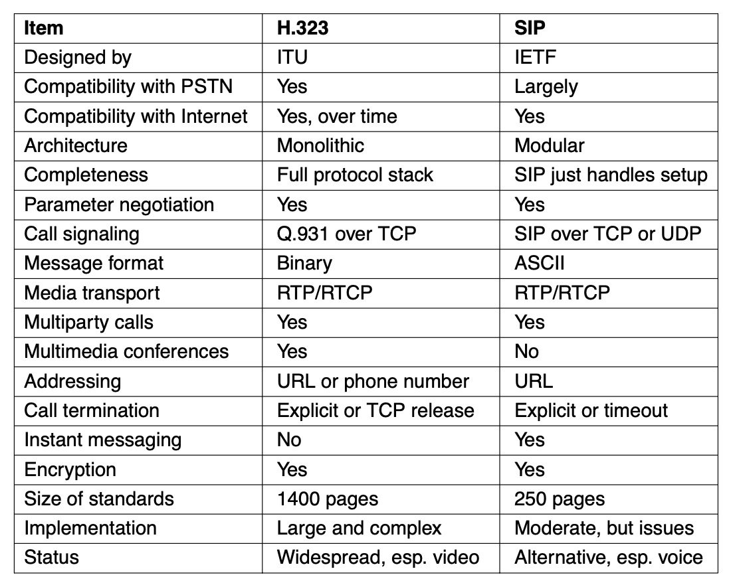
Real-Time Streaming (7 of 7)
Comparison of H.323 and SIP

Slide 60
Content Delivery
Content and Internet traffic
Server farms and Web proxies
Content delivery networks
Peer-to-peer networks
Evolution of the Internet

Slide 61
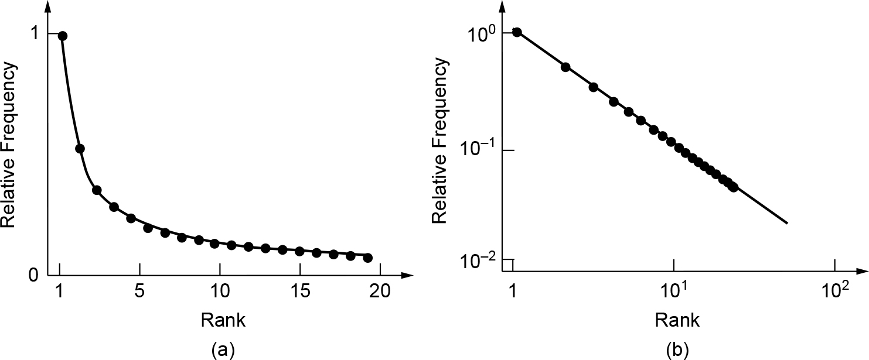
Content and Internet Traffic
Zipf distribution (a) On a linear scale. (b) On a log-log scale

Slide 62
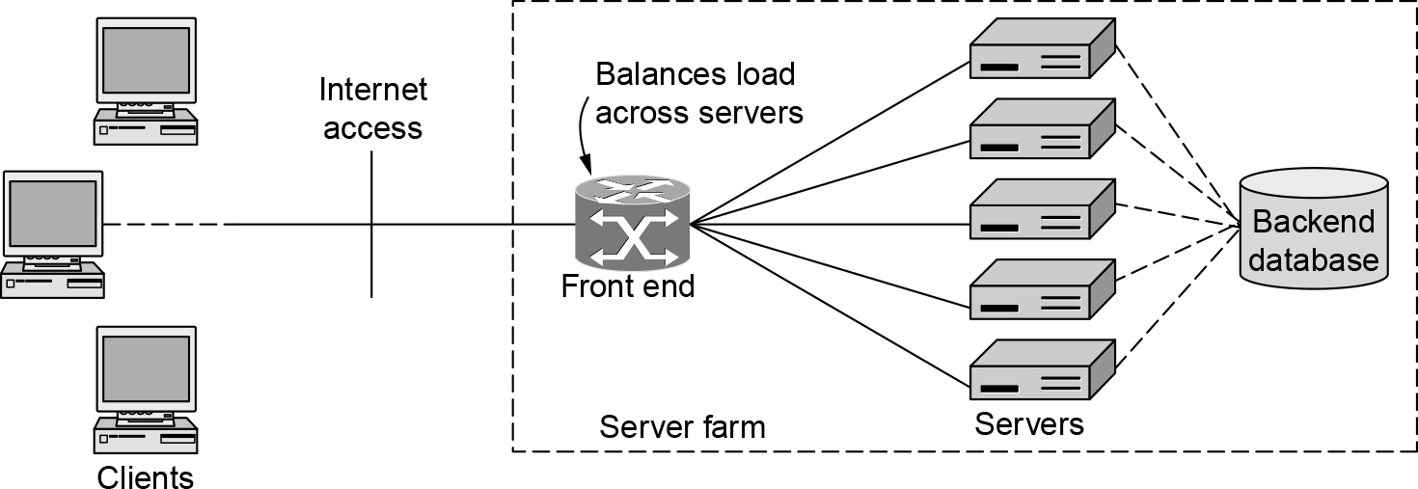
Server Farms and Web Proxies (1 of 2)
A server farm

Slide 63
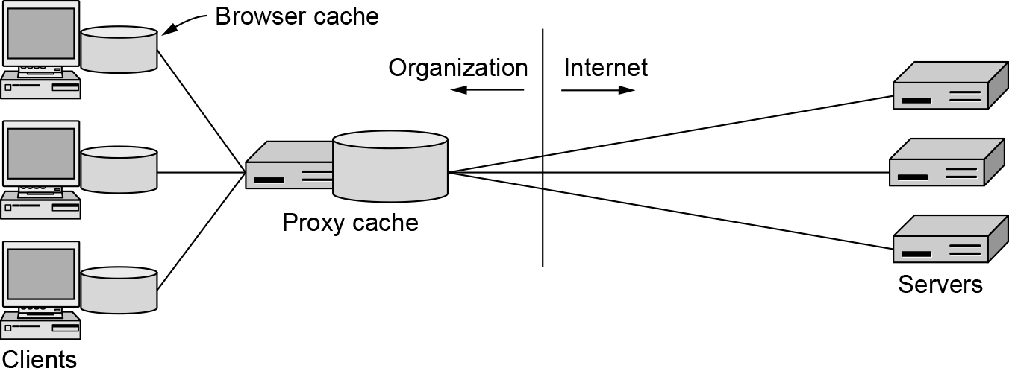
Server Farms and Web Proxies (2 of 2)
A proxy cache between Web browsers and Web servers

Slide 64
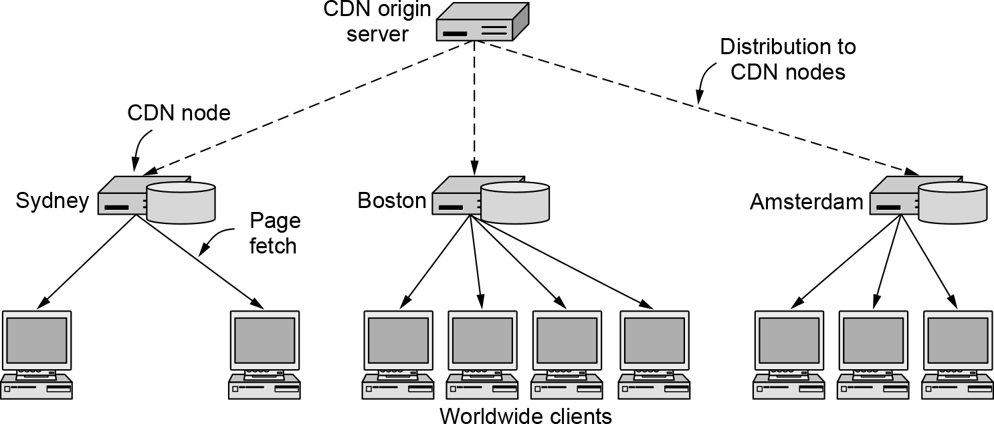
Content Delivery Networks (1 of 2)
CDN distribution tree

Slide 65
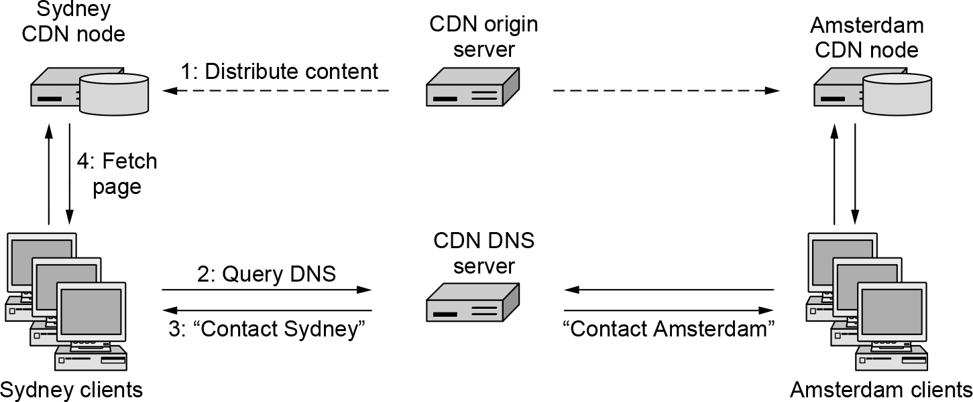
Content Delivery Networks (2 of 2)
Directing clients to nearby CDN nodes using DNS.

Slide 66
Peer-to-Peer Networks (1 of 3)
Overview
Early peer-to-peer networks: Napster
Decentralizing the directory: Gnutella
Coping with scaling, incentives, and verification: BitTorrent

Slide 67
Peer-to-Peer Networks (2 of 3)
Problems to be solved with BitTorrent sharing
How does a peer find other peers?
How is content replicated by peers to provide high-speed downloads?
How do peers encourage each other to upload content to others?

Slide 68
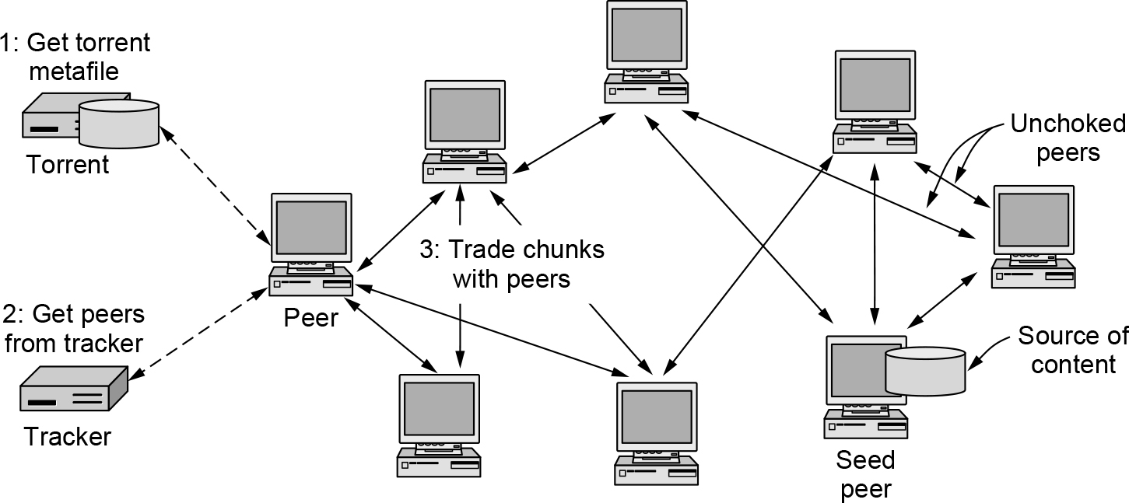
Peer-to-Peer Networks (3 of 3)
BitTorrent

Slide 69
Evolution of the Internet (1 of 3)
ARPANET and the early Internet components
Hosts (the computers that did the work for the users)
Routers (called IMPs in the ARPANET) that switched the packets
Transmission lines (originally 56-kbps leased telephone lines)

Slide 70
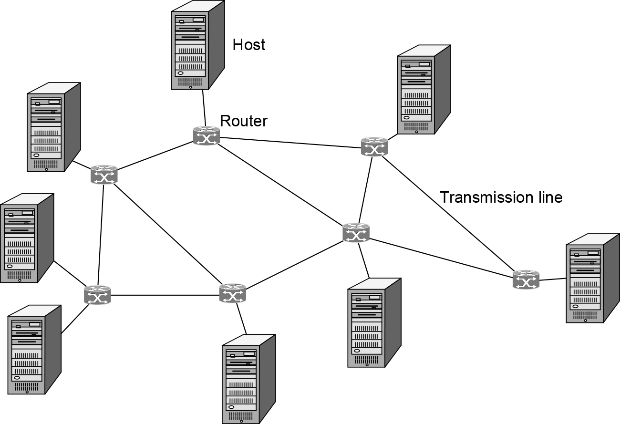
Evolution of the Internet (2 of 3)
The early Internet involved primarily point-to-point communications

Slide 71
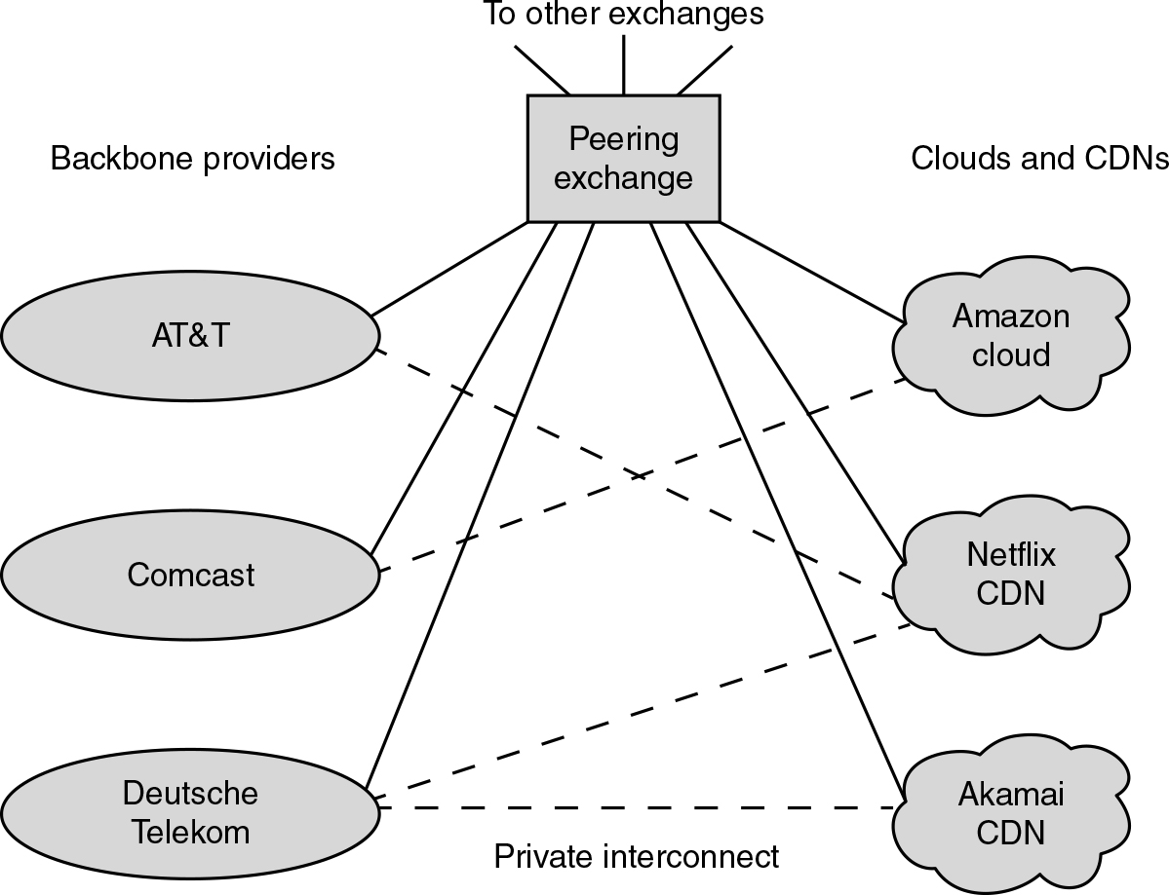
Evolution of the Internet (3 of 3)
Most Internet traffic today is from clouds and CDNs, with a significant amount of traffic being exchanged between access networks and ISPs over private interconnects.

Slide 72

Copyright
This work is protected by United States copyright laws and is provided solely for the use of instructors in teaching their courses and assessing student learning. Dissemination or sale of any part of this work (including on the World Wide Web) will destroy the integrity of the work and is not permitted. The work and materials from it should never be made available to students except by instructors using the accompanying text in their classes. All recipients of this work are expected to abide by these restrictions and to honor the intended pedagogical purposes and the needs of other instructors who rely on these materials.

